Slide 1
Chapter Two
Input, Processing, Output
*Based on Starting Out with Python by Tony Gaddis

Slide 2
Chapter Two – Input, Processing, Output
2.2 Input-Process-Output
2.3 Displaying Output with the Print Function
2.5 Variables
2.6 Reading Input from the Keyboard
2.7 Performing Calculations – Using Operators
2.1 Designing a Program
2.4 Comments
2.8 More About Data Output

Slide 3
2.2 Input – Process – Output
INPUT - Input is any data that the program receives while it is running (ex. Typed into the keyboard)
PROCESS - Next, some processing occurs, such as a mathematical calculation
OUTPUT - The results are sent out of the program as output
This chapter is about basic ways to perform these steps

Slide 4

2.3 Displaying Output with the print Function
A function is a piece of prewritten code. Python has numerous built-in functions. print is the most basic.
When you execute a function you are calling the function.
Inside the parenthesis following a function are arguments. Arguments vary depending on the function.

Slide 5
2.3 Displaying Output with the print Function
Statements execute in the order they appear.

Slide 6
Strings and String Literals
String – A sequence of characters used as data
String Literal – String that appears in program code. Strings within a program must be surrounded by quotes. They can either be surrounded by single or double quotes.
‘Kate Austen’
‘123 Full Circle Drive’
‘Asheville, NC 28899’
Notes:
Examples using single and double quotes

Slide 7
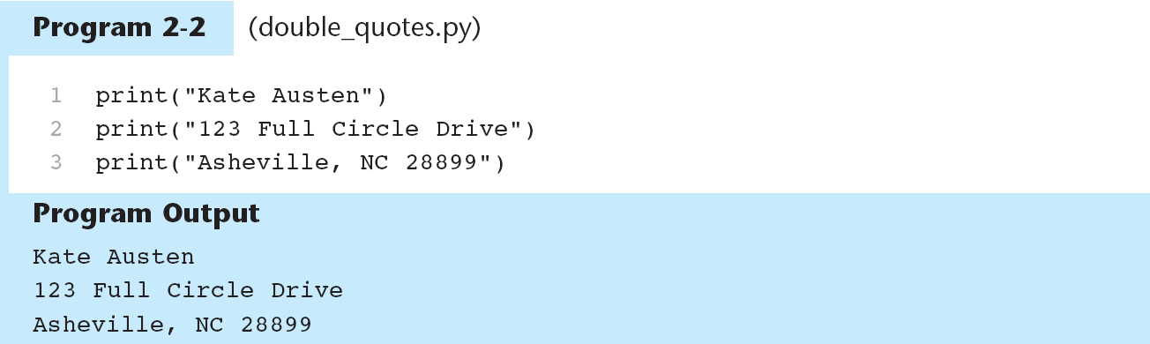
Strings and String Literals
If you want your literal to contain a single quote or apostrophe, use double quotes:
print (“Don’t fear!”)
Notes:
Examples using single and double quotes

Slide 8
2.5 Variables
Variable - a name that represents a value stored in the computer’s memory
Compare variables in programming to variables in math
Programs use variables to access and manipulate data that is stored in memory
A variable refers to a location in memory
Example: A program calculating sales tax on a purchase might use the name tax to represent that value in memory
Defining variables in other languages vs. Python
Notes:
How variables are used in math

Slide 9
Using Assignment Statements
Assignment statements are used to create a variable and make it reference a location in memory
age = 25
The equal sign means assignment of a value to a variable
The assignment statement has the general format:
variable = expression

Slide 10
Using Assignment Statements
Variables can be arguments in functions:
>>> width = 10
>>> length = 5
>>> print (width)
>>> print (length)
WARNING: A variable cannot be used until it has a value assigned to it

Slide 11
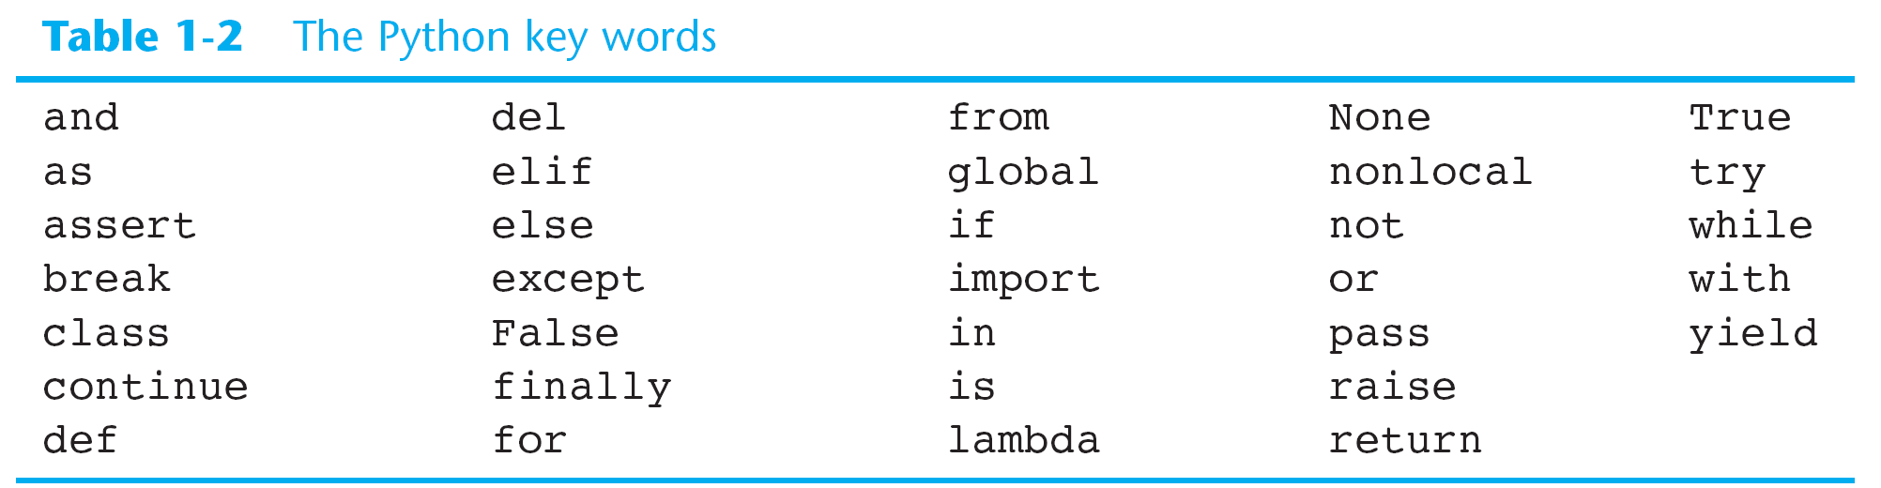
Python Key Words

Slide 12
Variable Naming Rules
May not be one of Python’s key words
May not contain spaces
First character must be an upper or lowercase letter (A-Z) or an underscore ( _ )
After the first character you may use upper and lowercase (A-Z), digits 0-9, or an underscore
Variable names are case-sensitive. ItemsOrdered is not the same variable as itemsordered.

Slide 13
Variable Naming Conventions
Conventions are styles used by programmers
Readability is key when writing programs
Use variable names that are meaningful
Convention is to use all lowercase for variable names
tax
width
height

Slide 14
Variable Naming Conventions
When more than one word is used, separate by underscore or use camelCase.
gross_pay
tickets_sold
topSpeed
itemsSoldToday

Slide 15
Displaying Multiple Items with the print Function

Slide 16
Variable Reassignment
Variables will reference a value until you assign it a different value:

Slide 17
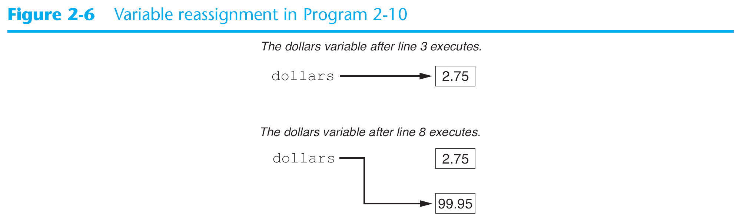
Variable Reassignment

Slide 18
Numeric Data Types and Literals
Real numbers (numbers with fractional part ex. 2.75) are stored differently in memory than integers (ex. 99).
Python uses different data types to store different types of numbers:
int – stores integers
room = 503
float – stores real numbers (floating point)
dollars = 2.75

Slide 19
Numeric Data Types and Literals
Numeric literal – a number written into a program’s code. Whole numbers are considered int and numeric literals with decimal points are considered float.
type function displays the data type of a variable or numeric literal:
>>> type (1)
<class ‘int’>
>>> type (1.0)
<class ‘float’>

Slide 20
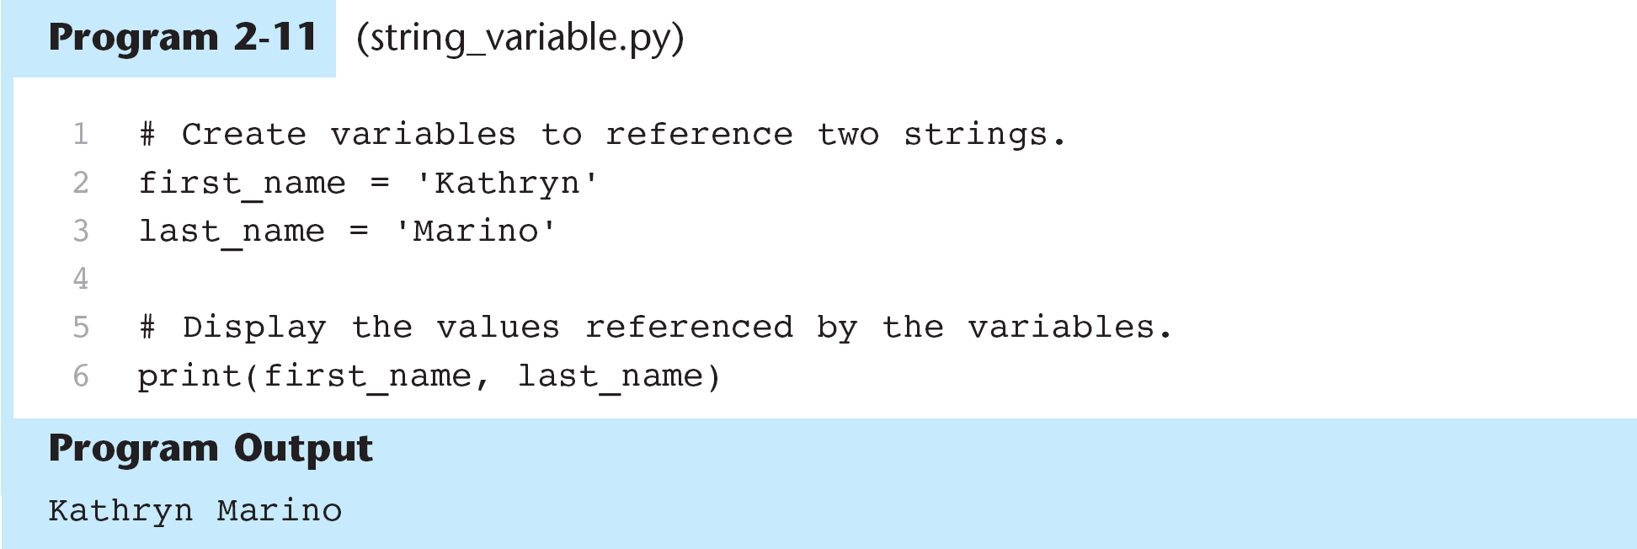
Storing Strings with the str Data Type

Slide 21
Reassigning a Variable to a Different Type
A variable is a name that refers to a piece of data in storage
After a variable has been assigned to data of one type, it can be reassigned to data of another type.
>>> x = 99
>>> print (x)
99
>>> x = ‘Take me to your leader’
>>> print (x)
Take me to your leader

Slide 22
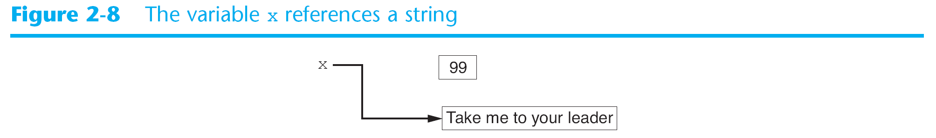
Reassigning a Variable to a Different Type

Slide 23
Checkpoint
Which are illegal in Python?
X
99bottles
July2009
theSalesFigureForFiscalYear
r&d
grade_report

Slide 24
Checkpoint
What is the data type of the variable after each of these expressions?
value1 = 99
value2 = 45.9
value3 = 7.0
value4 = 7
value5 = ‘abc’

Slide 25
2.6 Reading Input from the Keyboard
Most programs need input to perform an operation
One basic form of input is reading data typed into the keyboard
Python uses the input function to allow input from the keyboard
Typical format of the input function is an assignment statement:
variable = input (prompt)

Slide 26
2.6 Reading Input from the Keyboard
Example:
>>> name = input (‘What is your name? ’)
>>> What is your name? John
>>> print(name)
>>> John
Note that the last character of the “prompt” is space

Slide 27
Reading Input from the Keyboard
Get string_input.py

Slide 28
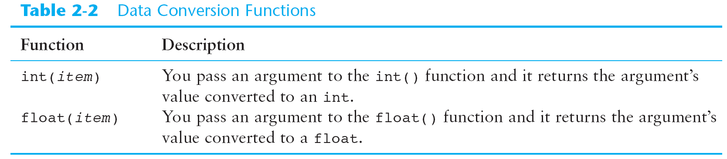
Reading Numbers Using the input Function
The input function always returns the user’s input as a string, even if a number is entered
This can be a problem if you want to use the input in a math operation
Python has built-in functions to convert a string to a number:

Slide 29
Reading Numbers Using the input Function
Example: You are writing a payroll program and you want to get the number of hours the user has worked:
string_value = input(‘How many hours did you work? ‘)
hours = int(string_value)
The first statement gets the number of hours from the user and assigns it as a string to string_value
The second statement converts it to an int

Slide 30
Reading Numbers Using the input Function
This method is inefficient because it creates two variables. Here is a better approach:
hours = int(input(‘How many hours did you work? ‘))
This is using nested function calls.

Slide 31
Reading Numbers Using the input Function
Note: int and float functions work only if the item being converted contains a valid numeric value
Notes:
Display input.py in IDLE. Run OK and with errors

Slide 32
Checkpoint
You need the user of a program to enter a customer’s last name. Write a statement that prompts the user to enter this data and assigns the input to a variable.
You need the user of a program to enter the amount of sales for the week. Write a statement that prompts the user to enter this data and assigns the input to a variable.

Slide 33
2.7 Performing Calculations – Using Operators
Python has numerous operators to perform mathematical calculations
Values to the left and right of the operator are operands
Variables may be used in math expressions
Notes:
Python shell – do simple operations with +,-, * Also use variables

Slide 34
Performing Calculations – Using Operators

Slide 35
Calculating a Percentage
If you are writing a program that uses a percent, make sure the decimal point is in the correct location before doing math.
We have been asked to write a program to calculate the sale price of an item after the discount is subtracted. Here is the algorithm:
Get the original price
Calculate 20 percent of the original price
Subtract the discount from the original price. This is the sale price.
Display the sale price.
How do we write the code?
See program sale_price.py

Slide 36
Performing Calculations – Floating Point and Integer Division
Python has two different division operators:
/ is for floating point division – gives the result as a floating point value
>>> 5 / 2
2.5
// is for integer division - gives the result as an integer
>>> 5 // 2
2
If the result is positive, the result is truncated – the fraction is thrown away
If the result is negative, it is rounded away from zero to the nearest integer
>>> -5 // 2
-3
Notes:
Shell 5 % 2

Slide 37
Performing Calculations – Exponent and Remainder
Exponent - **
>> 2**2
4
>> num = 15
>> num**5
759375
Remainder - % (modulus operator)
>>> 5/2
2.5
>>> 5%2
1
See program time_converter.py
Notes:
Shell 5 % 2

Slide 38
Operator Precedence
PEMDAS
Parentheses: ( )
Exponentiation: **
Multiplication, division, and remainder: *, /, //, %
Addition and subtraction: +, -
Operators with the same precedence execute from left to right

Slide 39
Operator Precedence – Grouping with Parentheses
Parentheses may be used to force some operations to be performed before others

Slide 40
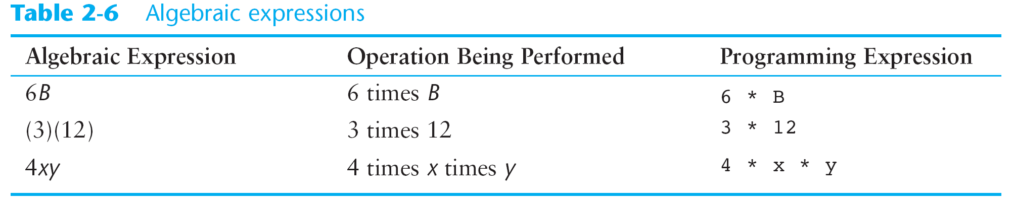
Converting Math Formulas to Programming Statements
In math you do not always need an operator. Ex. 2xy .
In Python and other languages you must use operators

Slide 41
Converting Math Formulas to Programming Statements

Slide 42
Mixed – Type Expressions and Data Type Conversions
When you perform an operation the data type of the result will depend on the data types of the operands. Python has the following rules:
If the operation is on two int values, the result will be an int.
If the operation is on two float values, the result will be a float.
When the operation is on an int and a float, the result will be float.

Slide 43
Calculating an Average
The average is the sum of numbers divided by the number of values
average = a + b + c /3
Is this correct?
average = (a + b + c) /3
See test_score_average.py

Slide 44
In-Class Assignment Ch. 2-1
Write a Python program to do the following:
Write a 1-2 line comment at the beginning of your program
In three separate input statements, ask the user to enter the costs for the following items: Hamburger, Fries, Shake.
Calculate the total cost and display with appropriate message (Example: The cost is: $45)
Calculate the average cost and display with appropriate message (Example: The average cost is: $15)
Note: Don’t worry about displaying cents to 2 decimals.
Print and turn in when complete.

Slide 45
2.1 Designing a Program
Programs must be carefully designed before they are written
Tools such as pseudocode and flow charts are used to create models of programs
The entire process is called the Program Development Cycle

Slide 46
The Design Process
Understand the task the program is to perform – usually the programmer interviews the customer to understand the business function or software requirement of the program
Determine the steps that must be taken to perform the task - Break down the task into a series of steps also known as an algorithm, or the logical steps necessary to perform a task.
Ex. Our task is to calculate and display gross pay for an hourly paid employee. What are the steps?
Get the number of hours worked
Get the hourly pay rate
Multiply the number of hours worked by the hourly pay rate
Display the result of the third step

Slide 47
Pseudocode
Sometimes it is helpful to write the program in pseudo or “fake” code. It allows you to think through the program using code-like steps without having to worry about exact syntax
Each statement represents an operation to be performed in Python
Pseudocode can be later translated into actual code:
Input hours worked
Input hourly pay rate
Calculate gross pay = hours worked multiplied by pay rate
Print gross pay

Slide 48
Using Input-Process-Output Diagrams to Write Pseudocode
I
Output
Input
Process
hours worked
pay rate
read in hours worked
read in pay rate
calculate gross pay = hours worked x pay rate
display gross pay
gross pay

Slide 49
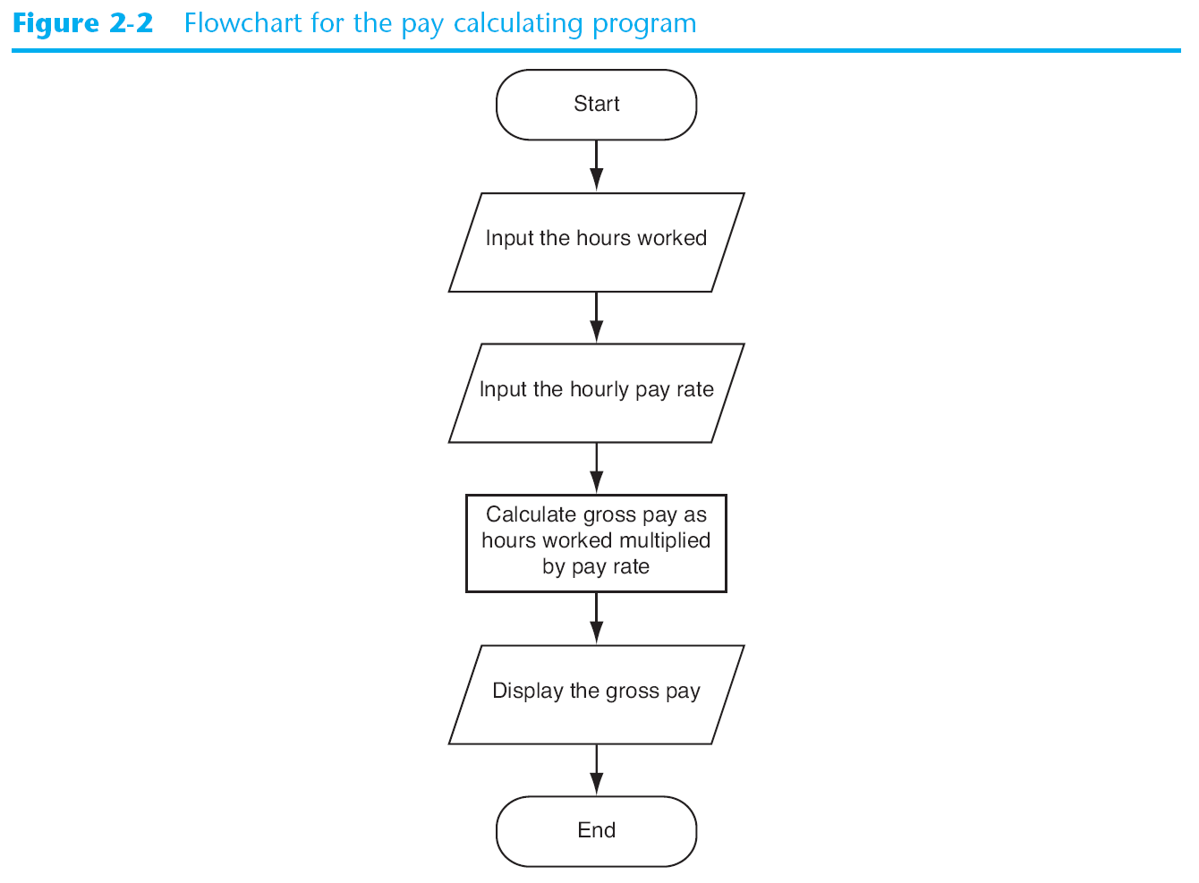
Flowcharts
Ovals – terminal symbols
Parallelograms – Input and Output
Rectangles - processing

Slide 50
Checkpoint
Who is a programmer’s customer?
What is a software requirement?
What is an algorithm?
What is pseudocode?
What is a flowchart?
What do each of these mean in a flowchart?
Oval
Parallelogram
Rectangle

Slide 51
2.4 Comments
Comments are notes of explanation written inside the program
The Python interpreter ignores them
They are written for anyone who might be reading the program
In Python, comments begin with the # character. Everything in the line after the # is ignored
They should be at the beginning of the program to explain what the program does
They should also be used to explain various sections of the program and complex logic
They are required in your lab assignments

Slide 52
2.4 Comments

Slide 53
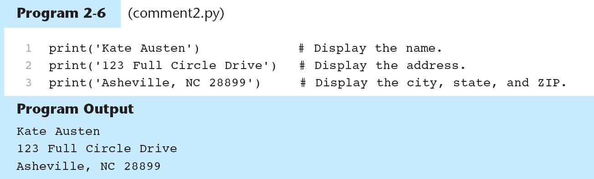
2.4 Comments
End-line comments appear at the end of a line of code to explain the statement that appears in that line.

Slide 54
Breaking Long Statements into Multiple Lines
Most programming statements are written on one line
However, if the line is too long to be seen in the editor without scrolling horizontally, it will be difficult to read
The solution is to break it into two lines, using the backslash \ (continuation character)
print (‘We sold’, units_sold, \
‘ units for a total of ‘, sales_amount )
result = var1 * 2 + var2 * 3 + \
var3 * 4 + var4 * 5

Slide 55
2.8 More about Output – More about print
print normally displays a line of output followed by an unseen newline character (\n).
print (‘One’)
print (‘Two’)
print (‘Three’)
Will display a string and a newline
One
Two
Three
To suppress the newline character do this:
print (‘One’, end = ‘ ‘)
print (‘Two’, end = ‘ ‘)
print (‘Three’)
Which will display:
One Two Three

Slide 56
2.8 More about Output – More about print
Multiple arguments to print result in a space separating each argument.
print (‘One’,‘Two’,‘Three’)
One Two Three
To suppress the space character do this:
print (‘One’,‘Two’,‘Three’,sep = ‘’)
OneTwoThree
You can also use other characters:
print (‘One’,‘Two’,‘Three’, sep = ‘, ’)
One, Two, Three

Slide 57
Escape Characters
Escape Characters are special characters preceded with a backslash (\) appearing inside a string literal.
These are treated as special commands to the print function

Slide 58
Escape Characters
Examples:
print (‘Mon\tTues\tWed’)
Mon Tues Wed
print (“Read \”Hamlet\” by tomorrow.”)
Read “Hamlet” by tomorrow
print (‘I\’m ready to begin.’)
I’m ready to begin

Slide 59
Displaying Multiple Items using +
With two strings, the + operator performs string concatenation
Examples:
Print (‘This is’ + ‘one string’)
This is one string
Print (‘For each day,’ +\
‘enter the number of‘ +\
‘hours worked: ‘)
For each day enter the number of hours worked:

Slide 60
Formatting Numbers

Slide 61
Formatting Numbers
The format function allows you to format numbers
format (numeric value,format specifier)
Format specifier is a string that contains special characters specifying how the numeric value should be formatted
print(format (12345.6789, ‘.2f’))
12345.68
In the above format statement:
.2 represents the precision. It indicates that we want to round to two decimal places
f specifies that the data type is float

Slide 62
Formatting Numbers

Slide 63
Formatting Numbers: adding $ and ,
The $ is contained in the string literal preceding the format function
The , is one of the special characters added to the specifier argument to the format command

Slide 64
Specifying a Minimum Field Width
The format specifier also can include a minimum field width which is the minimum number of spaces used to display the value.
>> print (‘The number is’, format (12345.6789, ‘11,.2f’))
>> The number is 12,345.68

Slide 65
Formatting a Floating-Point Number as a Percentage
Instead of using f as the type designator, use the % sign. The % causes the number to be multiplied by 100 and displays % following it.
In the second example, 0 as a precision will suppress the zeros after the decimal point
>> print (format (0.5, ‘%’))
>> 50.000000%
>> print (format (0.5, ‘.0%’))
>> 50%

Slide 66
Formatting Integers
Use d as the type designator, no precision can be specified
In the second example, 0 as a precision will suppress the zeros after the decimal point
>> print (format (123456, ‘d’))
>> 123456
>> print (format (123456, ‘,d’))
>> 123,456

Slide 67
Programming Style Requirements
Required for Lab Assignments - Discuss

Slide 68
Chapter 2 – In-Class Assignment (Part 2)
First make an IPO diagram and then write a Python program to do the following, :
Accept input of monthly gross income from the user.
Accept input of monthly paycheck deductions (one number) from the user.
Calculate net monthly income.
Display the monthly net income with an appropriate label (Ex. Monthly net income is: ) followed by the result formatted in to 2 decimal places preceded by a dollar sign and comma separators ($nn,nnn.nn). Don’t forget to suppress the extra spaces.
Calculate yearly gross pay and display with appropriate label and formatting.
Calculate yearly net pay and display with appropriate label and formatting.
Run your program and make any corrections. Print out your program and turn in + IPO chart before you leave.

